Slide 1
Practice Session 1 Exploring our Aspirations and Concerns
Document prepared by UHV Team (uhv.or.in) and adopted by AICTE NCC-IP Sub-committee for Mentor Manual and related Materials for UHV-I
Suggestions for improvement are welcome
All Rights Reserved

Slide 2
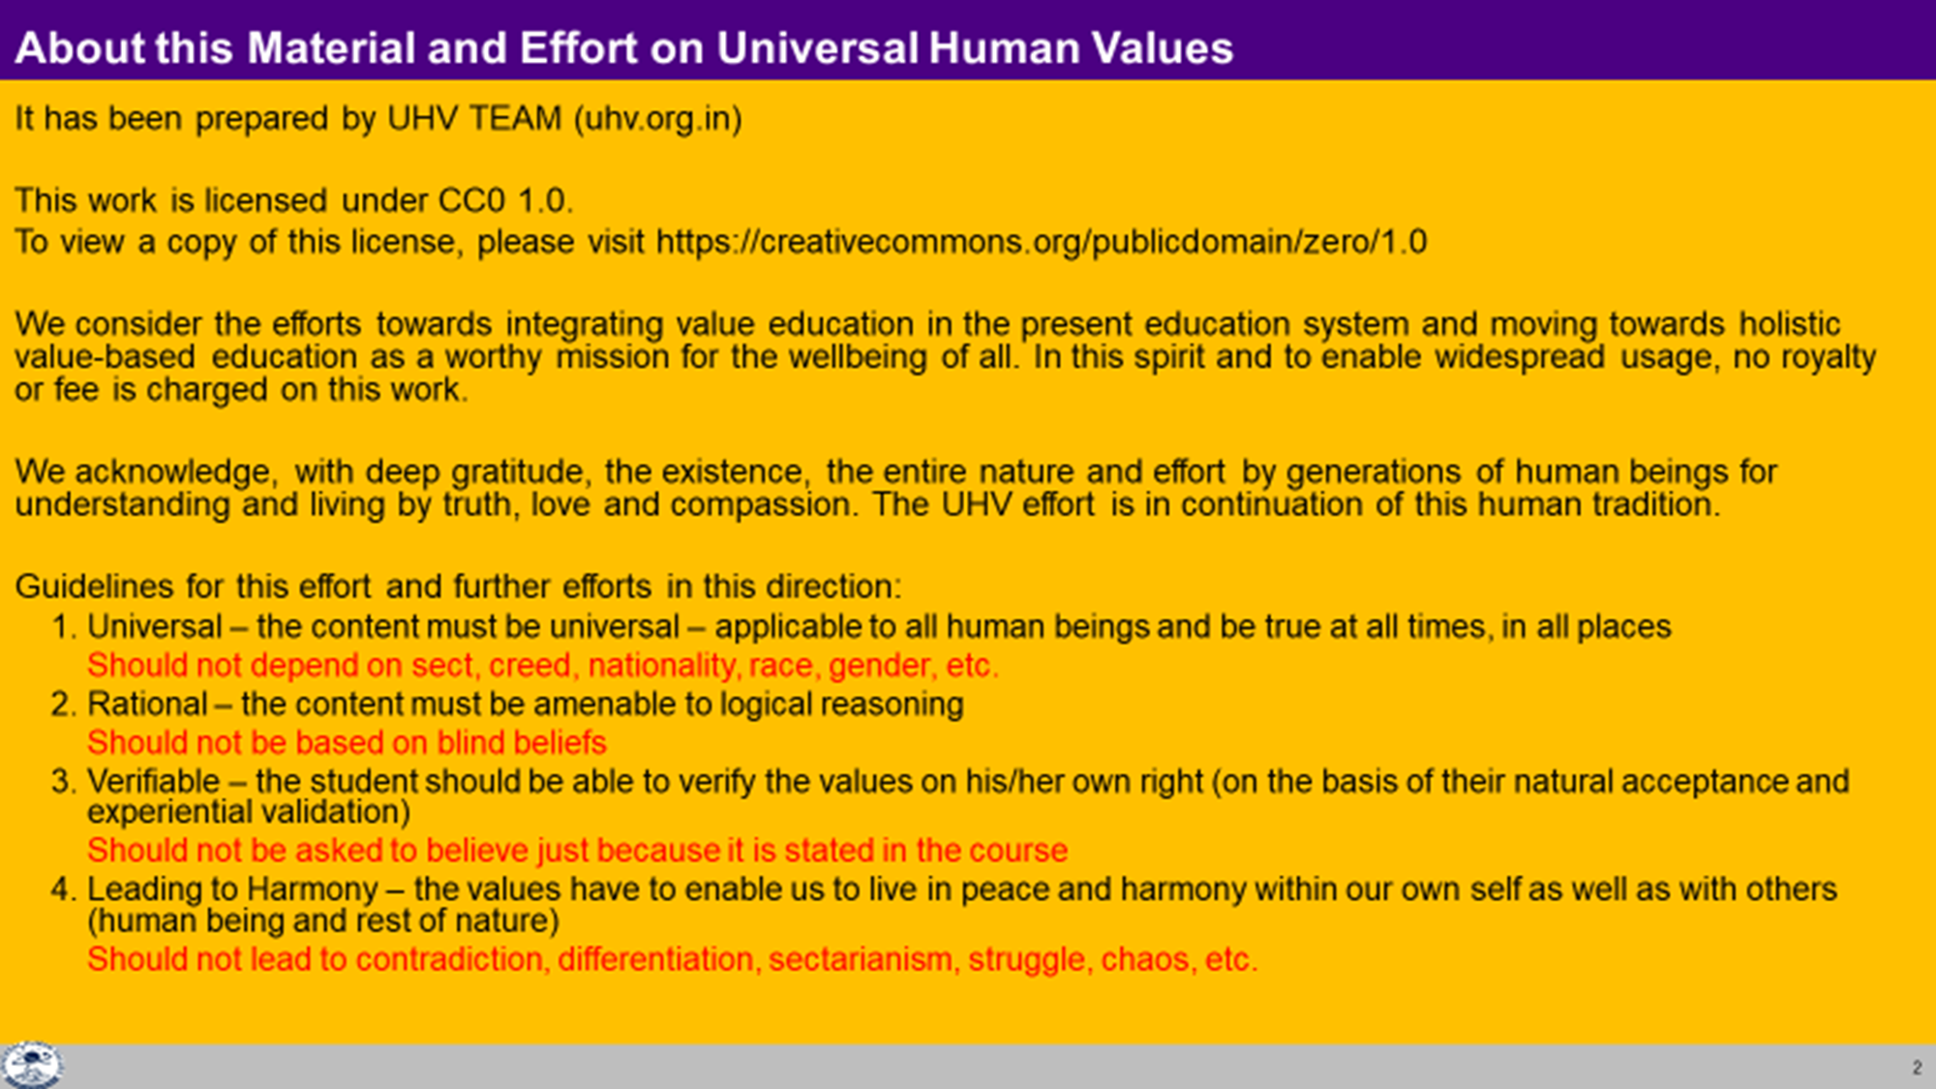

Slide 3
Interaction Before Main Session
Hear from participants about their exploration from previous day(s)
Q&A
Place some expected conclusions, find out if they also came to these/similar conclusions

Slide 4
Aspirations and Concerns
You must have completed your home assignment:
Make a list of your aspirations (चाहना), the expectations (अपेक्षा) of your family and friends and the hopes (आशा) you see the nation has from you.
Make a list of your achievements in your life
Make a list of your concerns, fears, confusions, questions, etc.
Let us get some of the points from these lists on the board
Aspirations | Achievements | Concerns
To do well in college | Came first in my class | Tension, peer pressure
Happiness in the family |  | Anger, not much time for family

Slide 5
Practice Session 1 Exploring our Aspirations and Concerns
Document prepared by UHV Team (uhv.or.in) and adopted by AICTE NCC-IP Sub-committee for Mentor Manual and related Materials for UHV-I
Suggestions for improvement are welcome
All Rights Reserved

Slide 6
Aspirations and Concerns
Aspirations | Achievements | Concerns
To do well in college | Came first in my class | Tension, peer pressure
Happiness in the family |  | Anger, not much time for family

Slide 7

Effort
We are all making tremendous effort!
Is the effort (प्रयास) that you are making:
To fulfil your aspirations (चाहना)?
or
To resolve your concerns (चिंता),confusions (भ्रम) and questions (जिज्ञासा)?
or
For something else?
Make a list of all the effort that you are making
Note down why you are making that effort
(to fulfil your aspirations or to resolve your concerns or for something else)
For example:
I am studying hard… so that I do well in class… and get a good job… so that…
I do what my mother wants… to express my respect to her… so that…
I am saving my pocket money… to buy a mobile for my brother… so that…
We will explore this further

Slide 8
Present Effort
(thinking, doing something)
Expect to become something
?
why you are
making this effort
Studying | Engineer
Doing Internship | Doctor
Practicing | Farmer
Attending Coaching | IAS Officer
Doing Articleship | Lawyer/CA
Doing MBA | Businessman
Researching | Scientist
Painting | Artist

Slide 9
Present Effort
(thinking, doing something)
Expect to become something
?
why you are
making this effort
Studying | Engineer

Slide 10
?
Expect to get/do something
Present effort
Expect to become something
??
why you are making this effort
Studying | Engineer | Get Money Earn Name, Fame Do Research, Innovation Take care of your parents Make your family/nation proud Gain Expertise in area of your choice Earn your living well Live with Self Respect Get Power in society Earn Respect Get Satisfaction And so on…
Doing Internship | Doctor
Practicing | Farmer
Attending Coaching | IAS Officer
Doing Articleship | Lawyer/CA
Doing MBA | Businessman
Researching | Scientist
Painting | Artist

Slide 11
?
Expect to get/do something
Present effort
Expect to become something
??
why
why
Studying | Engineer | Get Money

Slide 12
Present effort
?
Expect to become something
??
Expect to get/do something
???
Expect to BE something
why
why
why
Studying | Engineer | Get Money Earn Name, Fame Do Research, Innovation Take care of your parents Make your family/nation proud Gain Expertise in area of your choice Earn your living well Live with Self Respect Get Power in society Earn Respect Get Satisfaction And so on…
Doing internship | Doctor
Practicing | Farmer
Attending coaching | IAS Officer
Doing articleship | Lawyer
Doing MBA | Businessman
Researching | Scientist
Painting | Artist
Happy and prosperous
Effort for a fulfilling Life

Slide 13
Present effort
?
Expect to become something
??
Expect to get/do something
???
Expect to BE something
why
why
why
Studying | Engineer | Get Money
Happy and prosperous
Effort for a fulfilling Life

Slide 14
Present effort
(1)
Expect to become something
(2)
Expect to get/do something
(3)
Expect to be happy and prosperous
(4)
?
??
???
Which one is your basic aspiration (1 or 2 or 3 or 4)?
Can you see that your basic aspiration is to be happy and prosperous?
Can you see that becoming something, doing something, getting something etc. are just the steps to achieve your basic aspiration?
Would you like to make sure that the steps you choose will lead to your happiness and prosperity?
These are steps toward our basic aspiration
It is a path to fulfilling our basic aspiration
Basic Aspiration
Fulfilling Life

Slide 15

Present effort
(1)
?
Expect to become something
(2)
??
Expect to get/do something
(3)
???
Expect to be happy and prosperous
(4)
How would you like to plan your life?
1-2-3-4: Plan the steps without being clear of your basic aspiration?
or
4-3-2-1: Develop clarity of your basic aspiration (happiness and prosperity) and then work out the steps?
Check how you are planning now
These are steps toward our basic aspiration
It is a path to fulfilling our basic aspiration
Basic Aspiration
Fulfilling Life

Slide 16
Life without Clarity of Basic Aspiration
If the basic aspiration (where you want to reach and stay there) is not clear, then it is likely that:
The direction of your effort may keep changing (as assumptions change)
You may not know if you have arrived or not
Very likely that there will be a mix of satisfaction and dis-satisfaction (appiness and unhappiness)
Present effort
The Basic Aspiration (Goal)
is not clear or it is vague, like:
Aim for the sky
Make money and have fun
…
Expect to become something
???
Expect to get/do something

Slide 17
Life with Clarity of Basic Aspiration (Goal)
(1) Our basic aspiration (human goal) is very clear – the destination is fixed
(2) We know our current state (right evaluation)
(3) We plan steps that connect and lead to
the fulfillment of basic aspiration
– direction is definite
Our basic aspiration is definite
It does not keep changing
(It seems to be the same
for all human beings)
(1)-Basic Aspiration
Fulfilling life
To BE always
happy and
prosperous
(निरंतर सुख)
Thinking, doing something
Expect to become something
Expect to get/do something
(3)-Direction of effort →
(2)-Current State
(कभी ख़ुशी, कभी ग़म)

Slide 18
Many Paths or only One?
Now that we can distinguish between basic aspiration and the steps or path to fulfill it, find out what would be appropriate if your “favourite” path is closed:
Be unhappy, get depressed, become inactive?
Find an alternate path?
Examples:
I wanted to go to the US for my degree, but I was forced to take admission here by my parents. My dreams are shattered
I did not get the branch of my choice. My motivation to study is gone
I did not get the room mate I wanted. I am unhappy

Slide 19
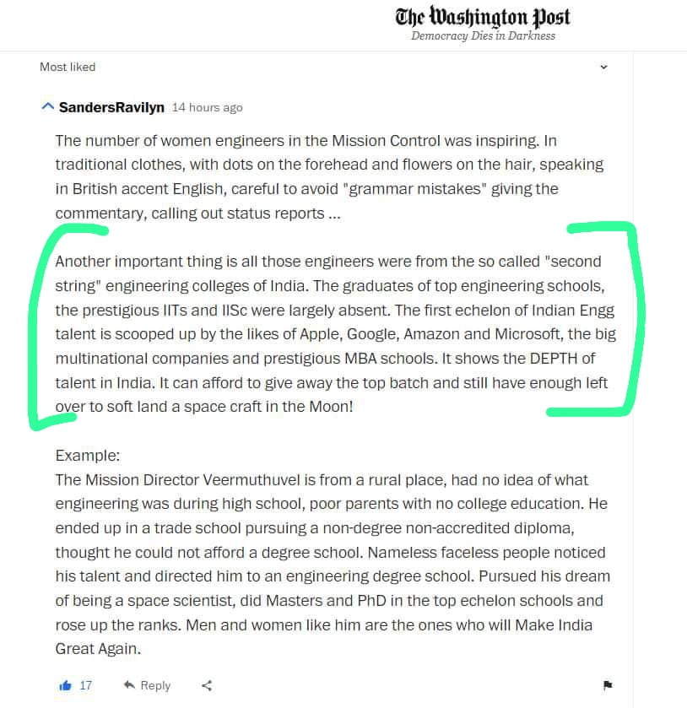

Slide 20
Home Assignment

Slide 21
Home Assignment
2.1. Write your conclusions / takeaways from this session
2.2. Is your basic aspiration really happiness (सुख) and prosperity (समृद्धि) or something else?
2.3. Think about some of those situations where your favourite path to what you assumed to be your goal was closed
What did you feel, think, do in these situations?
Write down one of them in detail
To be written in your UHV-I Notebook

